Slide 1
BLOG
Image here of the home
NOSQL, SoSe 17 10.07.2017, Berlin
Akarsh Seggemu
Budankailu Sameer Kumar Subudhi Sonali Bhatnagar
Image here of the create blog post

Slide 2
Agenda
1.
Description
2.
Databases
3.
Live demo

Slide 3
Description
Description to do
Here goes architecture diagram

Slide 4
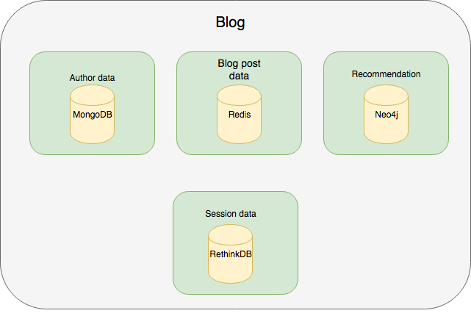
Databases: Architecture

Slide 5
NOSQL Databses: MongoDB
Mongoose
Elegant MongoDB object modeling for Node.js

Slide 6
NOSQL Databses: Redis

Slide 7
NOSQL Databses: RethinkDB
Session storage

Slide 8
NOSQL Databses: Neo4j
Recommendation

Slide 9
Live demo

Slide 10
Questions?

